Slide 1
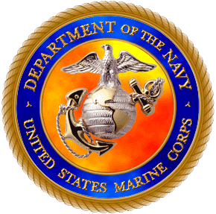

takes pleasure in presenting the
National Ensign
to
Gayle O. Davis
This Flag was flown over Camp Al Taqaddum. Iraq
Marine Corps Systems Command Site during Operation Iraqi Freedom 05-07
on this 20th day of February in the year of our Lord 2007
__________________________
M.B. Conwell
Staff Non-Commissioned Officer in Charge,
Marine Corps Systems Command Site
GySgt, United States Marine Corps
__________________________
M.S. Goodwin
Officer in Charge,
Marine Corps Systems Command Site
Major, United States Marine Corps

Slide 2
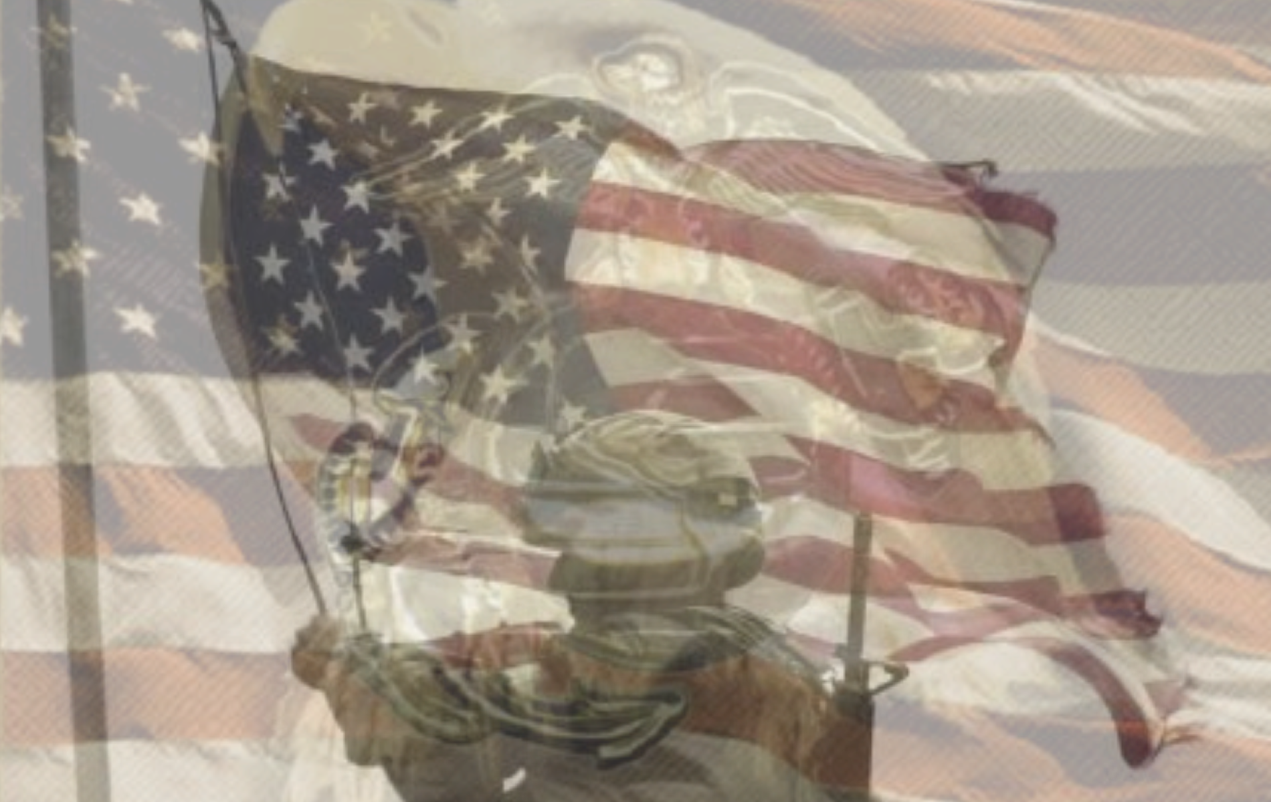
The Flag of the United States of America
This Flag represents the heroism and sacrifice of the Men and
Women of the Armed Forces of the United States of America.
Many service men and women have paid the ultimate price
by giving their lives in defense of the Iraqi people during their
fight for freedom.
Whenever and wherever this flag is displayed, it will always
carry with it, the memory of those who were lost while
bringing freedom to those who have never known it.
Operation Iraqi Freedom & Operation Enduring Freedom
“We will never forget”

